Slide 1
CAR RENTAL SYSTEM
JAVA • SWING • JDBC • MYSQL
Desktop Application Project Presentation
Presented by
Sameer Basha S & Ranjithkumar K
Computer Science and Engineering

Slide 2
PROBLEM STATEMENT
Why a dedicated car-rental management system is needed
• Manual rental records are difficult to maintain and update.
• Vehicle availability can be unclear or inconsistent.
• Customer and rental details need secure, organized storage.
• Manual charge calculations can cause errors.
• A centralized desktop system improves speed, accuracy and traceability.
02

Slide 3
OBJECTIVES
Core goals of the application
Vehicle Management
Add, view, update and delete vehicle records.
Customer Management
Maintain customer and license details.
Rental Management
Create rentals and track active/returned vehicles.
Billing
Calculate rental charges based on duration.
History
Review previous rental transactions.
03

Slide 4
KEY FEATURES
Functional modules in the desktop application
• Admin login and dashboard
• Car registration and availability management
• Customer registration and profile management
• Car rental and return workflow
• Automatic rental amount calculation
• Rental history and status tracking
• Database-backed CRUD operations
• Validation and user-friendly Swing dialogs
04

Slide 5
SYSTEM ARCHITECTURE
Layered architecture used for maintainability
SWING UI
LoginFrame • Dashboard • CarPanel • RentalPanel
CONTROLLER
Handles application actions and coordinates requests
SERVICE
Business rules and rental operations
REPOSITORY
CRUD and database access abstraction
JDBC + MYSQL
Persistent storage and SQL execution
05

Slide 6
TECHNOLOGY STACK
Technologies appropriate to the implemented desktop system
Java
Core programming language
Java Swing
Desktop graphical user interface
JDBC
Java-to-database connectivity
MySQL
Relational database
Maven
Dependency and project management
Eclipse IDE
Development environment
06

Slide 7
APPLICATION WORKFLOW
Typical flow from login to rental completion
Login
Dashboard
Customer
Available Car
Rental
Return
History
Every transaction follows the service → repository → JDBC → MySQL flow.
Presentation
Controller
Service
Repository
Database
07

Slide 8
Future Enhancements
Online Booking – Customers can reserve cars through a website or mobile app.
Online Payment – Add UPI/card payment for rental charges.
Email/SMS Notifications – Send booking and return reminders.
GPS Tracking – Track the location of rented vehicles.
Customer Reviews – Allow customers to rate and review cars/services.
08

Slide 9
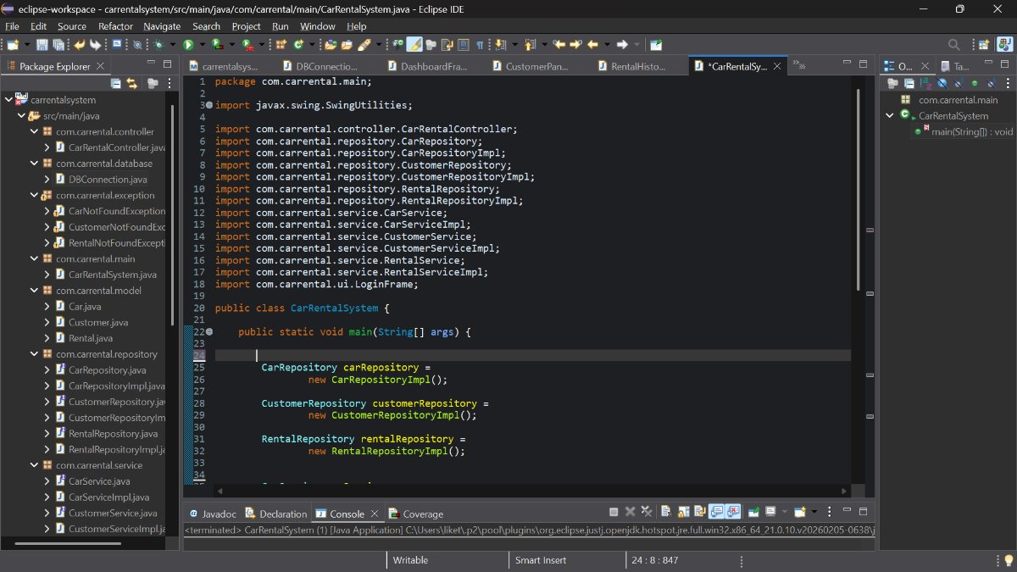
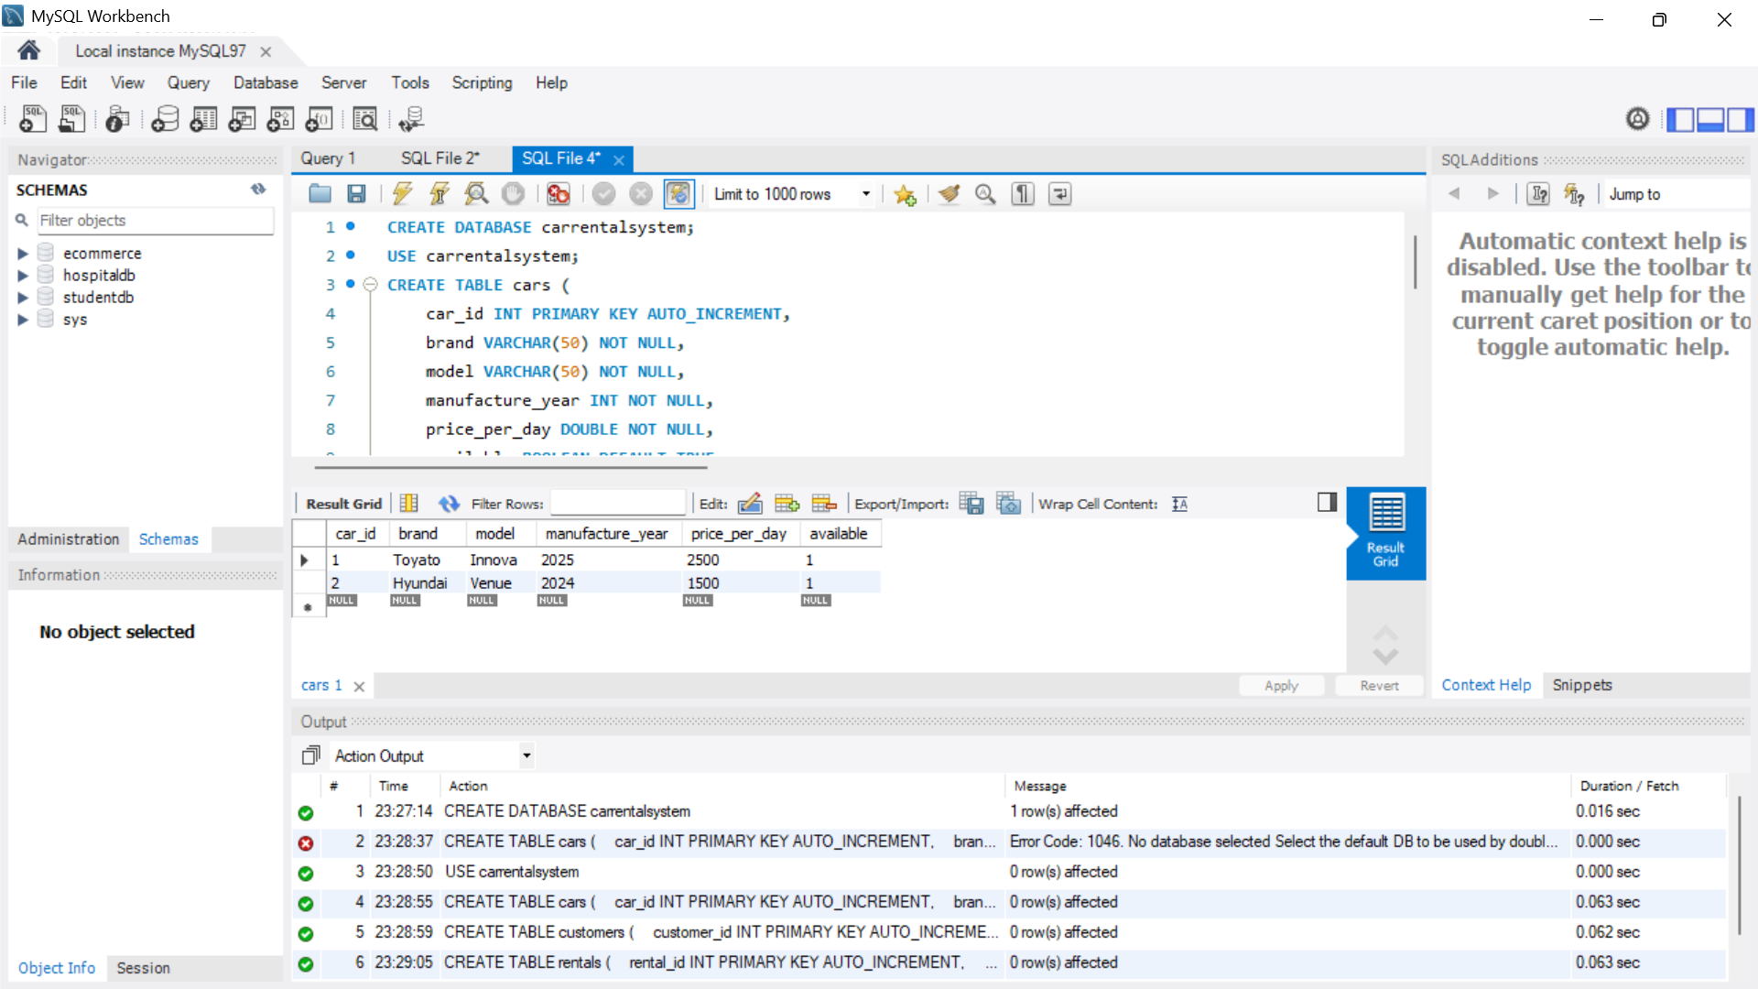
SCREENSHOTS / PROJECT IMAGES
09

Slide 10
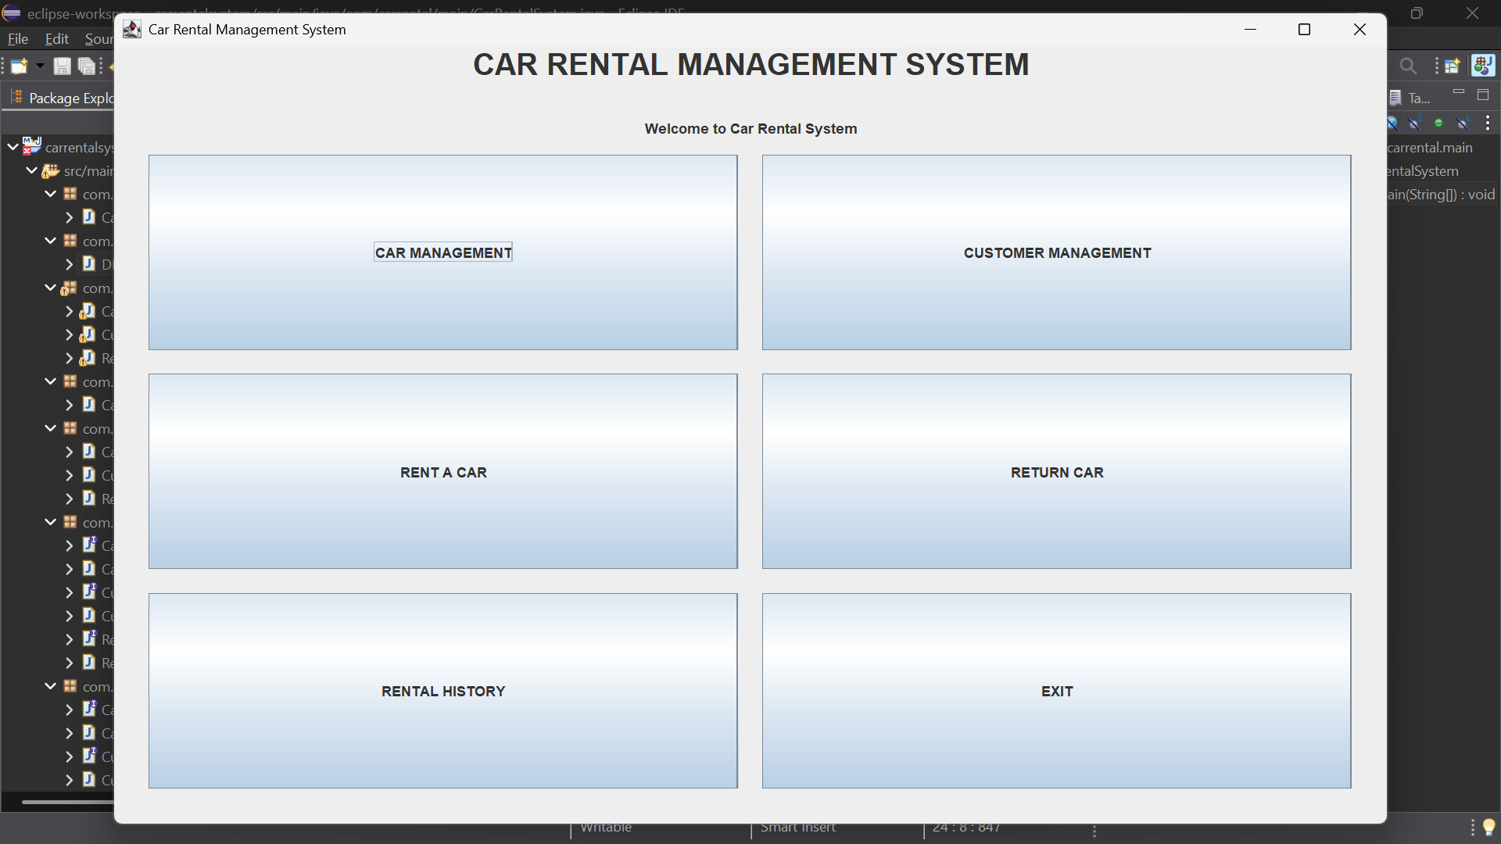
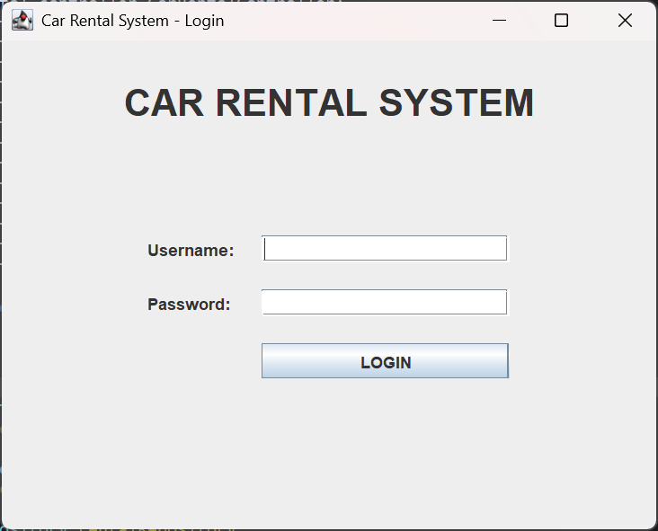
SCREENSHOTS / PROJECT IMAGES
10

Slide 11
CONCLUSION
Project outcome and future scope
• The Car Rental System makes vehicle rental simple and efficient.
• It helps manage customers, cars, bookings, and rental transactions.
• Java Swing provides an easy-to-use desktop graphical interface.
• JDBC and MySQL provide reliable database connectivity and data management.
• The project demonstrates practical use of Java, OOP, JDBC, and MySQL.
• Future enhancements can include online booking, payment integration, and admin reports.
“A smart system for a faster and easier car rental experience.”

